Slide 1
JACON
A racon response prototype
Emmy Hoorn · Sorin Jayaweera · Sofiia Zaozerska
Panthalassa Clinic · 29 September 2026
Notes:
JACON = Jason's RACON draft design, the architecture we are prototyping. Team: Emmy, Sorin, Sofiia.

Slide 2
Why
Radar sees a buoy.
A racon says which buoy.
$40k
15+ nm
PER COMMERCIAL UNIT
DETECTION RANGE
Notes:
Panthalassa: maritime safety and energy buoys. They own three racons, all mission critical, ~$40k each, one already in repair from overvoltage - so we prototype rather than borrow. Reference commercial unit: Tideland SeaBeacon 2. Only the letter R is required (NAVSAC 16-01).

Slide 3
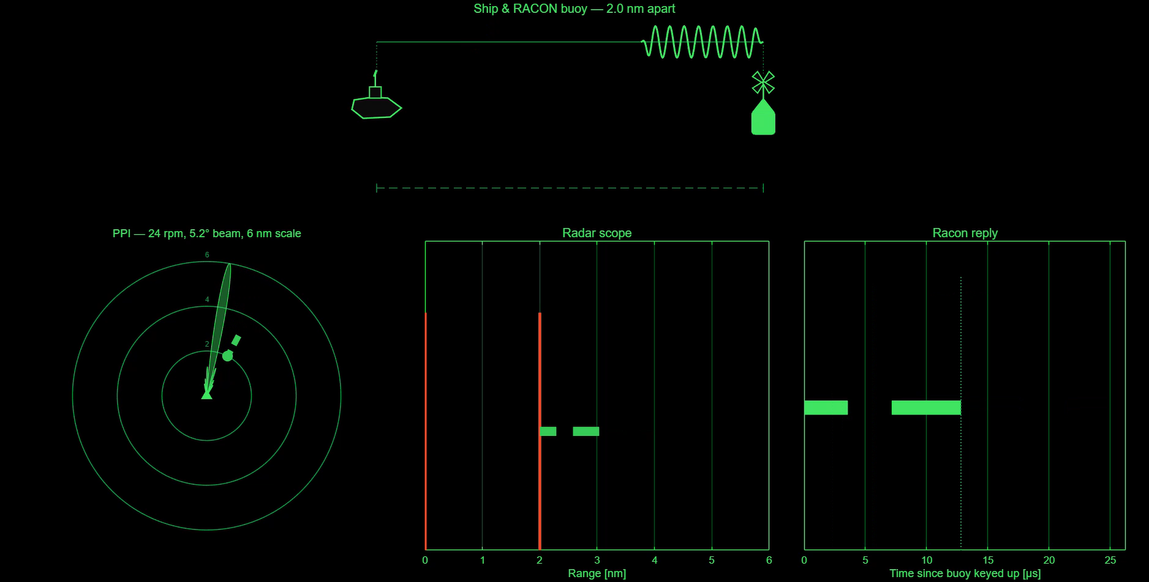
What it does
Every pulse gets an answer.
. — .
MORSE “R”
< 700 ns
25 µs
TO REPLY
OF MORSE
Simulated: the beam sweeps the buoy, the buoy answers, and the code
paints 2 nm beyond it — then fades until the next pass
Notes:
USCG: racons answer every radar pulse, begin replying <700 ns later, ~25 us of Morse, painted just beyond the structure's own echo. 25 us = 2.0 nm of painted code (range = c*t/2). At 24 rpm with a 5.2 deg beam the buoy sits in the beam for 36 ms, so it is interrogated about 22 times per pass on the long-range PRR of 600 Hz.

Slide 4
Numbers
9.3 – 9.5 GHz
2.9 – 3.1 GHz
< 700 ns
X BAND
S BAND
REPLY LATENCY
25 µs
~1 W
±5 / ±12 V
CODED REPLY
TRANSMIT, PULSED
ANALOG SUPPLY
Interrogating radar: 9.4 GHz, 0.08 – 0.8 µs pulses, 600 – 2100 Hz PRF, 24 rpm, 5.2° beam
Notes:
Bands and latency from the liaison and USCG. Radar figures are from the Furuno 18x4C/19x4C operator's manual specification page: 0.08 us / 2100 Hz on the 0.125-1.5 nm scales, 0.3 us / 1200 Hz on 1.5-3 nm, 0.8 us / 600 Hz on 3-72 nm; 24 rpm nominal; 5.2 deg horizontal beamwidth on the 2.2 kW radome, sidelobes -19 dB. Transmit ~1 W pulsed per the JACON drawing (liaison said 5 W at the upper end for a production unit).

Slide 5
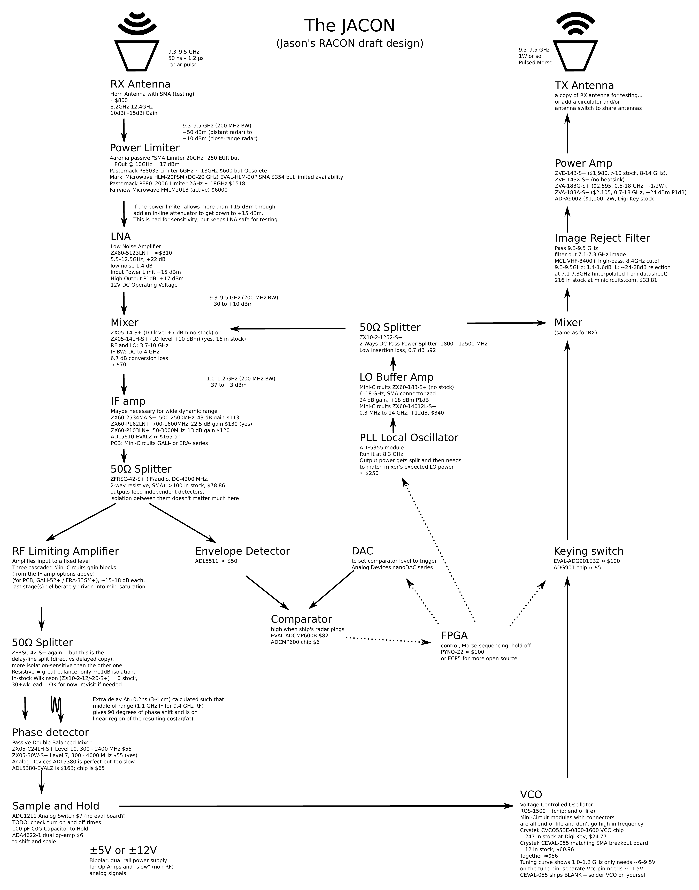
The JACON plan
Receive at 9.4.
Work at 1.1.
Answer at 9.4.
Superheterodyne both ways, around one 8.3 GHz local oscillator.
Jason's RACON draft design
Notes:
This is the drawing we are building to. Nine Mini-Circuits modules are already in hand; the rest are costed candidate parts. RX: horn, limiter, LNA ZX60-5123LN+, mixer ZX05-14LH-S+ against an ADF5355 PLL at 8.3 GHz, giving a 1.0-1.2 GHz IF. TX: VCO, keying switch, mixer back up, VHF-8400+ image-reject high pass, power amp, antenna.

Slide 6
Answering on the same frequency
We are told the band, not the frequency. So we measure it.
9.4 GHz
mix down
1.1 GHz
delay line
volts
VCO
in
8.3 GHz LO
IF
Δt ≈ 0.2 ns
hold
retunes
…then key the R and mix back up to 9.4 GHz.
One frequency in → one voltage out.
Linear across the whole 1.0 – 1.2 GHz band.
Δt picked so 1.1 GHz sits at 90°, mid-slope.
Notes:
This is the heart of the design and the part we are testing now. A racon has to answer within a fraction of a percent of the frequency it heard, but we only know the band. Split the 1.1 GHz IF, delay one copy by about 0.23 ns (3-4 cm of cable), mix the two: the DC output is K*cos(2*pi*f*dt). Choosing dt so that 1.1 GHz lands at 90 degrees puts the whole 1.0-1.2 GHz band on the linear part of the cosine, so the held voltage is a direct measure of the incoming frequency and can retune the VCO. Verified in LTspice against theory.

Slide 7
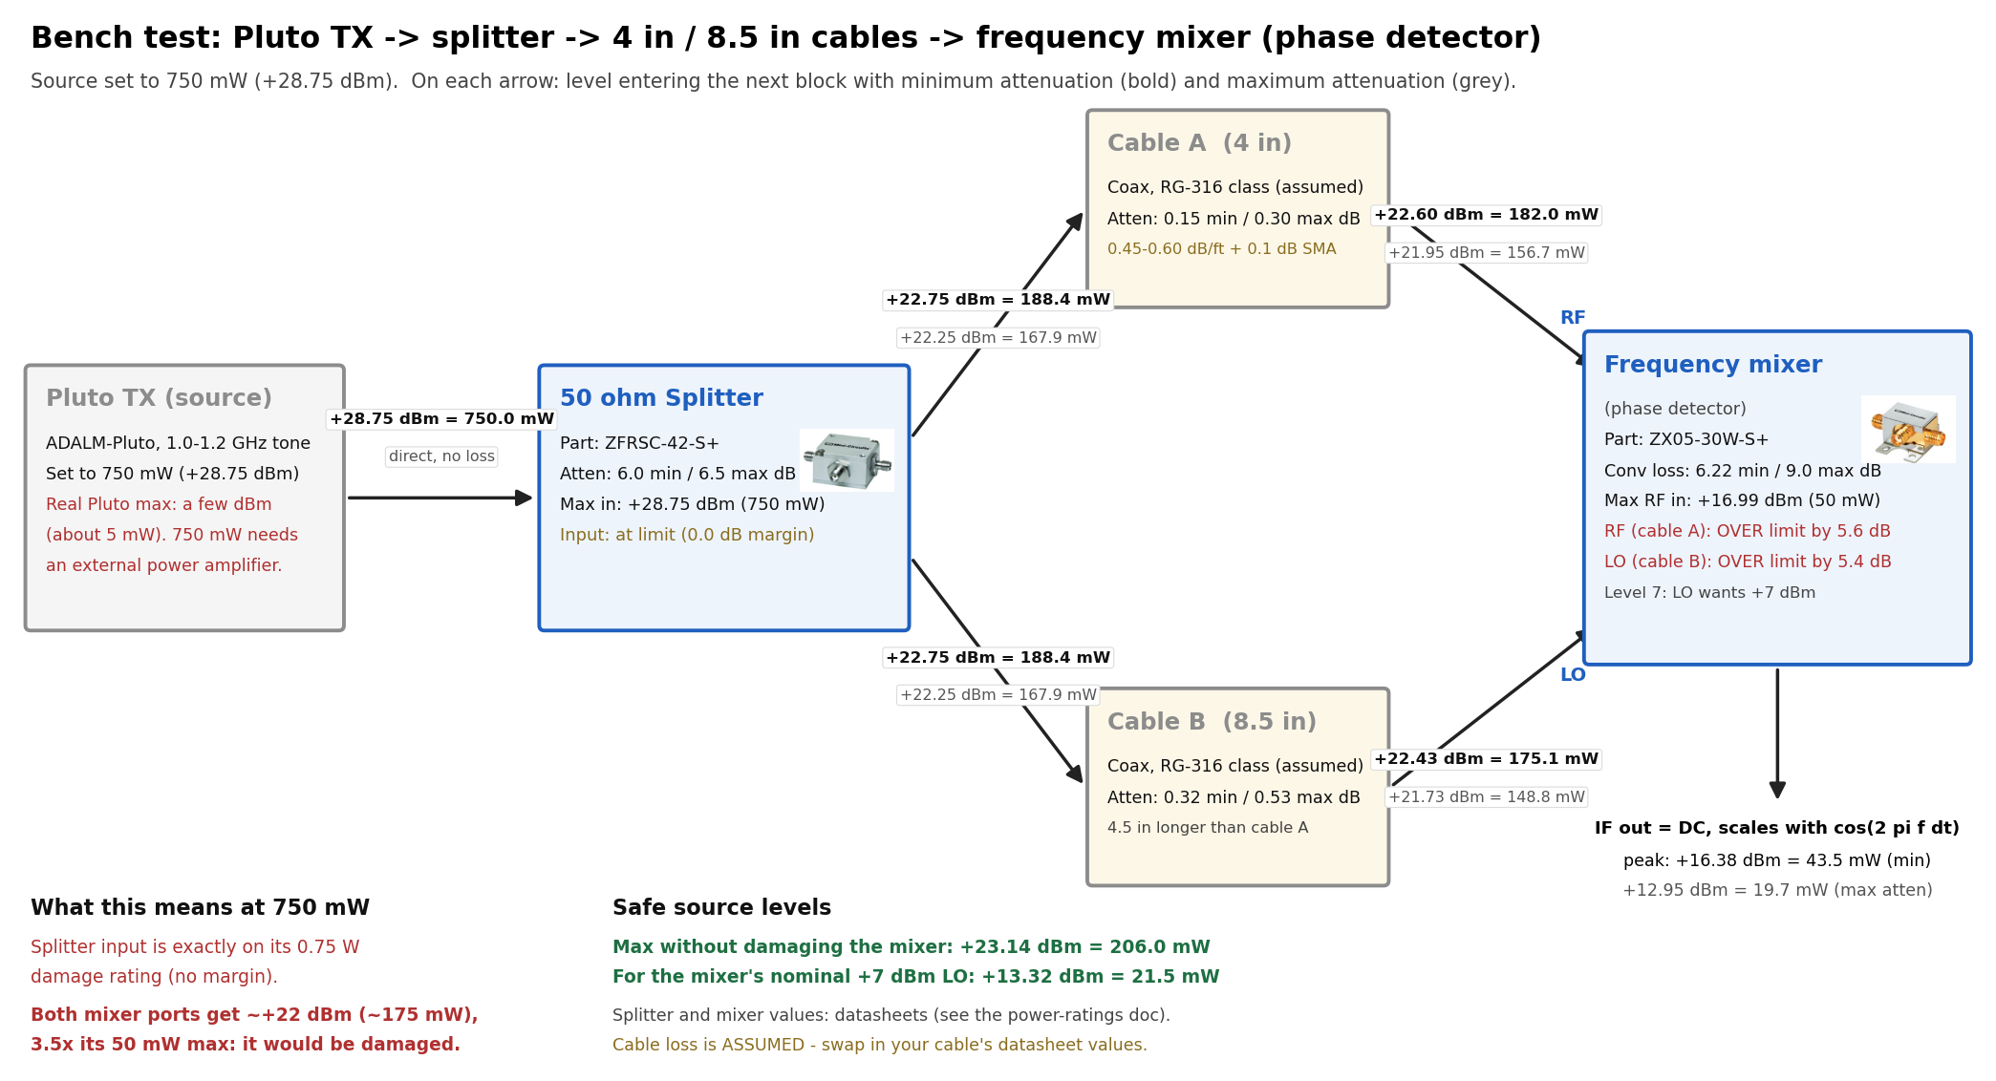
Where we are
DONE
Phase-detector bench test
Full LTspice model
Power budget, part by part
NEXT MONTH
Recover an unknown frequency on the bench.
END OF SEMESTER
A prototype that answers the Furuno.
Bench: Pluto → splitter → unequal cables → mixer
Notes:
The bench diagram is also a cautionary one: driven at 750 mW both mixer ports sit about 3.5x over the 50 mW maximum, which is probably why we saw a strange curve instead of a cosine - we may have damaged that mixer. Safe source level is about +13 dBm for the mixer's nominal +7 dBm LO. Interrogator for final testing is the Furuno radar at 24 V; stand well back.

Slide 8
Thank you
[ team photo in the lab ]
Emmy Hoorn · Sorin Jayaweera · Sofiia Zaozerska
Notes:
Drop the lab photo into the placeholder before presenting.

